Slide 1
Assignment
To create a high level concept type of fertilizers and pestisides required for agriculture products to be harvesten in monsoon
BY:-Yusuf j
KTC Hubli

Slide 2
What are monsoon crops
Kharif crops, which are also known as monsoon crops, are the crops that are grown during the monsoon or rainy season (June to October). These crops require a good amount of rainfall. Their seeds are sown at the beginning of the monsoon season. The crops are harvested at the end of the monsoon season.

Slide 3


Slide 4
What is Fertilizer
Fertilizers are chemical substances supplied to the crops to increase their productivity. These are used by the farmers daily to increase the crop yield. The fertilizers contain the essential nutrients required by the plants, including nitrogen, potassium, and phosphorus.

Slide 5
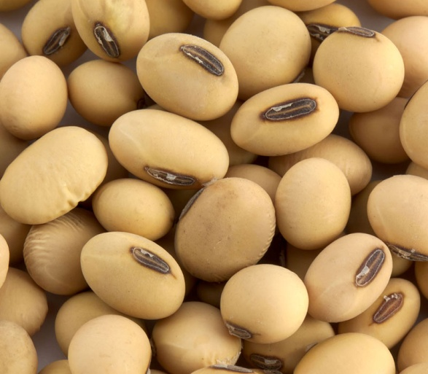
Soybean
Seed Treatment To protect seeds from soil borne diseases, treat seeds with Thiram or Captan@3 gm per kg of seeds.
Fertilizer Requirements (kg/acre)
.
UREA | SSP | MURIATE OF POTASH
28 | 200 | Apply if deficiency observed
Nutrient Requirements (kg/acre)
NITROGEN | PHOSPHORUS | POTASH
12.5 | 32 | Apply if deficiency observed
Apply FYM or well decomposed cowdung@4 ton/acre. Also apply Nitrogen@12.5 kg and Phosphorus@32 kg in form of Urea@28kg and SSP@200 kg per acre at time of sowing. To obtain good growth and optimum yield, take spray of Urea@3 kg/150 ltr of water on 60th and 75th day after sowing

Slide 6
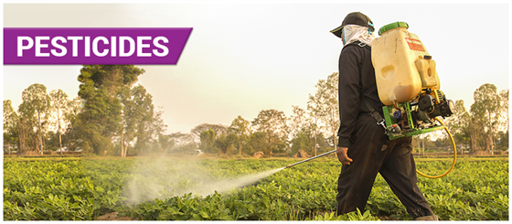
Pesticides are chemical compounds that are used to kill pests, including insects, rodents, fungi and unwanted plants (weeds). Over 1000 different pesticides are used around the world. Pesticides are used in public health to kill vectors of disease, such as mosquitoes, and in agriculture to kill pests that damage crops.

Slide 7
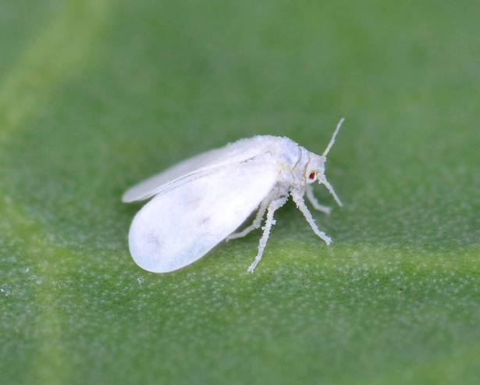
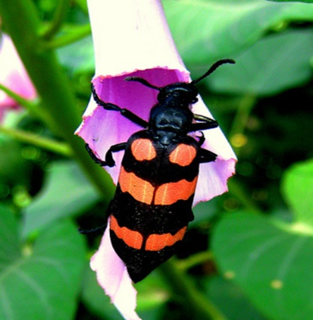
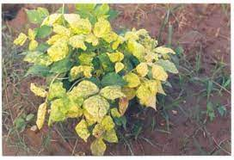
Pesticides require for soybean
Pest and their control:
White Fly: For white fly control, take spray of Thiamethoxam@40 gm or Triazophos@300 ml/acre. If necessary take second spray 10 days after first spray.
Blister beetle: They cause damage at flowering stage. They feed on flowers, buds thus prevent grain formation. If infestation is observed, take spray of Indoxacarb 14.5SC@200 ml or Acephate 75SC@800 gm/acre. Carry out spraying in evening hours and if necessary take second spray 10 days after first spray.
Disease and their control:
Yellow mosaic virus: It is spread due to white fly. Irregular yellow, green patches are observed on leaves. Pods not developed on infected plants. Grow yellow mosaic virus resistant varieties. For white fly control, take spray of Thiamethoxam@40 gm, Triazophos@ 400 ml/acre. If necessary take second spray 10 days after first spray.

Slide 8
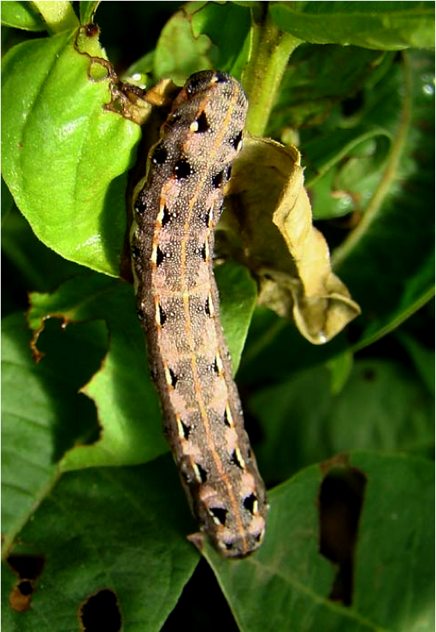
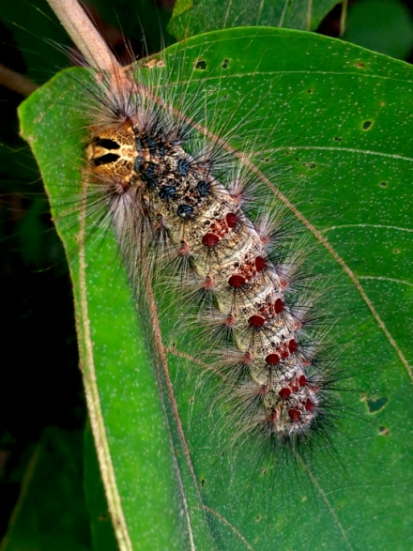
Tobacco caterpillar: If infestation is observed, take spray of Acephate 57SP@800 gm/acre or Chlorpyriphos 20EC@ 1.5 ltr/acre. If necessary take second spray 10 days after first spray.
Hairy Caterpillar: To control hairy caterpillar pick caterpillar manually and destroyed by crushing or putting in kerosene water when infestation is low. In case of high infestation, take spray of Quinalphos@300 ml or Dichlorvos@200 ml/acre.

Slide 9
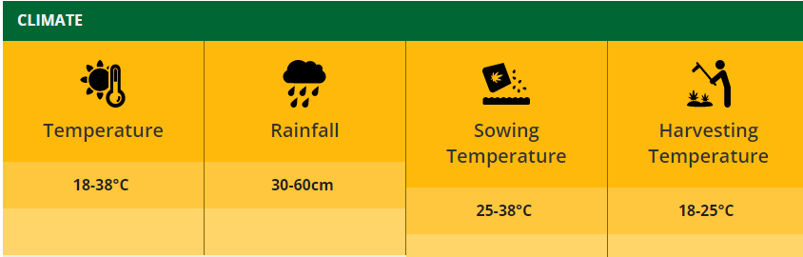
Climate and soil
Soybean is a warm season crop to grow in summer. And loamy well drained fertile soil is good for growing soybean. Land preparation for soybean should be done by proper ploughing followed by laddering.

Slide 10
Thankyou

